Slide 1
EDI End Semester assessment SEM I 2023-24 ​
Automatic Smart Gate Surveillance ​
Div:- CS B​
EDAI Group No.:- 8​
Date:- 25/11/2023​
Presented by- ​
Project Guide-​
Roll No.​ | Name ​ | PRN No.​
39 | Aastha Jain​ | 12211635
41 | ​Jannu | 12210209
48 | Aniket Kalbhor | 12210601
51 | Sujit Kanawade | 12211417
52 | Karan Harshey | 12210612
Dr. Ajay Keshav Talele​
​
Department of Multidisciplinary Engineering Vishwakarma Institute of Technology, Pune A.Y.(2023-2024) SEM 1

Slide 2
CONTENT
Introduction
Literature Review
Problem Statement
Objective of EDI Project
EDI Domain, technology and tools being used
Design- System Architecture
Methodology/Algorithm/Technique used
Executable Project Demo.
Result Discussion
Individual responsibility
Conclusion
Reference

Slide 3
INTRODUCTION​
Our project : Automatic Gate Survellience
Evolving to meet security demands, the Automatic Smart Gate Surveillance System automates access control.
-Integration of sensors and cameras facilitates verified entry of vehicles, ensuring safety in varied settings.
-Used in residences, schools, and more, it employs cutting-edge technology for efficient monitoring and enhanced security.

Slide 4
LITERATURE REVIEW
Sr. no | Title | Publication | Abstract
1 | An efficient automated vehicle license plate recognition system under image processing | Indonesian Journal of Electrical Engineering and Computer Science | This paper introduces an efficient automated license plate recognition system using image processing techniques with four modules: preprocessing, extraction, segmentation, and recognition, achieving a 94.17% accuracy in MATLAB. The system finds applications in various fields like access control and border security.
2 | A Robust Real-Time Automatic License Plate Recognition Based on the YOLO Detector | IJCNN | This paper introduces a robust ALPR system using YOLO object detection and CNNs, achieving a 93.53% recognition rate at 47 FPS in the SSIG dataset, surpassing commercial systems. In the UFPR-ALPR dataset, it achieves a 78.33% recognition rate at 35 FPS in realistic moving scenarios, outperforming commercial trials.

Slide 5
LITERATURE REVIEW
Sr. no | Title | Publication | Abstract
3 | Automatic License Plate Recognition | IEEE | This study introduces a robust LPR technique with high success rates: 97.9% in locating license plates and 95.6% in identifying numbers. Overall, the proposed algorithm achieves a 93.7% success rate across varied conditions, minimizing environmental constraints.
4 | Automatic Number Plate Recognition System (ANPR): A Survey   | International Journal of Computer Applications | This paper addresses the need for an ANPR system to overcome challenges in identifying speeding vehicles, proposing various approaches while considering image size, success rate, and processing time as critical parameters. Additionally, an extension to ANPR is suggested to further enhance its capabilities in recognizing vehicle plates under diverse conditions.

Slide 6
LITERATURE REVIEW
Sr. no | Title | Publication | Abstract
5 | Proposal for Automatic Vehicle Number Plate Recognition System in POLIMAS | Journal of Engineering and Science Research 4 | This paper proposes an AVNPR system for efficient vehicle identification at POLIMAS, enhancing campus security. Using image processing techniques like edge detection and OCR, it accurately detects and recognizes vehicle plate numbers, ensuring authorized access while conserving energy by activating the camera only when a vehicle is present.
6 | Implementing ALPR for detection of traffic violations: a step towards sustainability | International Conference on Computational Intelligence and Data Science | This Sustainable Transportation ALPR system identifies violations in enclosed spaces via image refinement and OCR. Matching plates trigger mobile warnings, enhancing safety by enforcing traffic rules in office or campus settings.

Slide 7
LITERATURE REVIEW
Sr. no | Title | Publication | Abstract
7 | Two Wheel Vehicle License Plate Detection System with Image Processing | The International Conference on Applied Engineering | Image processing aids in detecting vehicle license plates at Politeknik Negeri Batam, replacing the manual entry system. This system, using cameras and K-Nearest Neighbor method, achieves 84.5% accuracy in recognizing characters from license plates, streamlining vehicle entry records.
8 | Detecting Vehicle Numbers Using Google Lens-Based ESP32CAM to Read Number Characters | Jurnal Manajemen, Teknik Informatika, dan Rekayasa Komputer | This research used ESP32CAM for vehicle plate detection, utilizing Google Lens for text extraction. Results demonstrated high accuracy, reading six out of ten plates perfectly, despite one error linked to plate color.

Slide 8
PROBLEM STATEMENT
"The existing manual security monitoring methods are inefficient and error-prone, failing to swiftly and accurately detect threats, highlighting the urgent need for a comprehensive, automated surveillance system to bolster security in diverse environments."

Slide 9
OBJECTIVES​
​
To come up with a cheap surveillance system for household societies.
To serve as an alternative to current systems, which aren’t as robust while being expensive at the same time.
To ensure a reliable system so that no security elapses happen, and human error and time delay is minimized.

Slide 10
DOMAIN, TOOLS & TECHNOLOGY IN USE​
Camera Module- Camera module is a integral component within the Automatic Smart Gate Surveillance System, playing a pivotal role in data collection, analysis, and security enhancement.
Relay-It enables to controlled and secure access through their ability to switch high-power devices based on low-power signals.
Actuators- Actuators play a crucial role in the Automatic Smart Gate Surveillance System by converting control signals into physical actions, enabling efficient and precise gate operation.
Open CV- OpenCV (Open Source Computer Vision Library) serves as a foundational technology within the Automatic Smart Gate Surveillance System, enabling powerful image and video processing capabilities.
ThingsSpeak- facilitates real-time data collection and analysis from sensors and cameras.
NodeMCU integrates with ThingSpeak, enabling remote control and updates based on surveillance system data.
Database- Stores the number plates of the cars that are to be given access inside the premises
Domain- Security and Access control

Slide 11
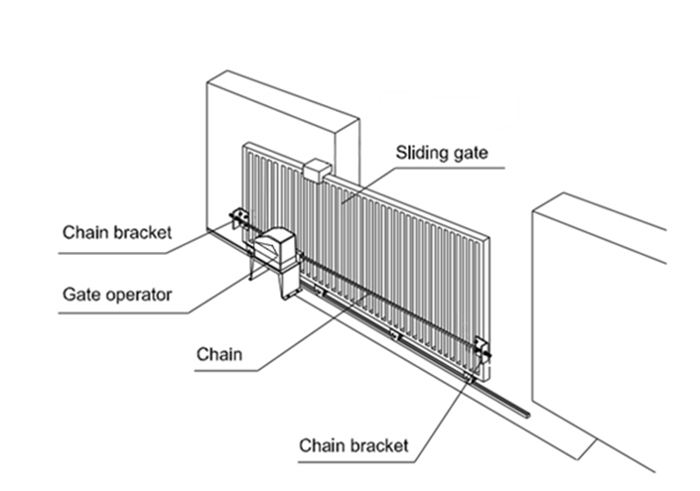
DESIGN – SYSTEM ARCHITECTURE

Slide 12
METHODOLOGY IMPLEMENTED​
First step is installation of camera systems to ensure vehicle number gets captured at entry points.
When a car comes by, the camera system captures it.
It detects the presence of a number plate, and the general area where the number plate is in the picture is marked.
The image then undergoes image processing.
Blur and make image grayscale
Apply filters and find edges for localization
Contouring and Masking
After this, EasyOCR algorithm is used for character recognition.
When recognized, it is parsed into text and pushes it to the stored database.
It tries to find a match within the current database.
If a match is found, the gate for the society opens.

Slide 13
RESULTS & DISCUSSIONS
The results are quite satisfactory, it performs all the functions which were initially thought of. Although, there still remains a large future scope for improvement and expansion of feature set. We can increase the accuracy of our model, and definitely use a better camera system, in order to improve recognition of blurry and bad quality images. Also, we can scale this project more by adding additional cameras.

Slide 14
CONCLUSION
Innovative autonomous smart gate surveillance and regulation system.
Unmatched security and safety improvements.
Prevents security lapses and strengthens precautions.
Saves time and money through automation.
Provides invaluable information and insights for ongoing enhancement.
Optimizes security operations and reduces unauthorized entrance.
Seamlessly integrates multiple security technologies.

Slide 15
THANK YOU !

